Slide 1
Closure Of Functional Dependency : Introduction
The Closure Of Functional Dependency means the complete set of all possible attributes that can be functionally derived from given functional dependency using the inference rules known as Armstrong’s Rules.
If “F” is a functional dependency then closure of functional dependency can be denoted using “{F}⁺”.
There are three steps to calculate closure of functional dependency. These are:
Step-1 : Add the attributes which are present on Left Hand Side in the original functional dependency.
Step-2 : Now, add the attributes present on the Right Hand Side of the functional dependency.

Slide 2
Step-3 : With the help of attributes present on Right Hand Side, check the other attributes that can be derived from the other given functional dependencies.
Repeat this process until all the possible attributes which can be derived are added in the closure.

Slide 3
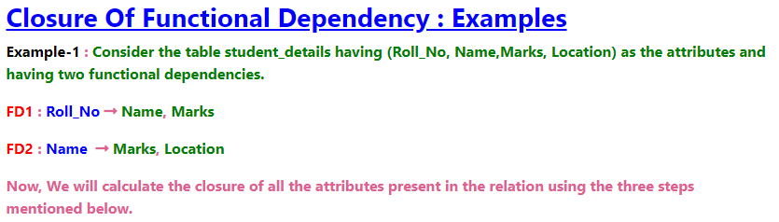
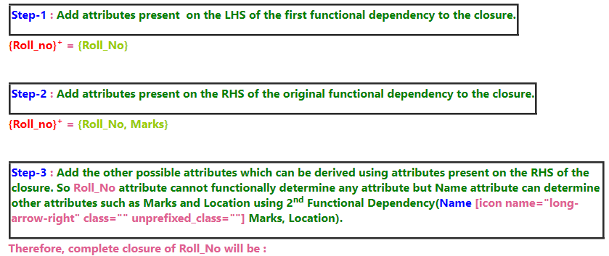

Slide 4


Slide 5
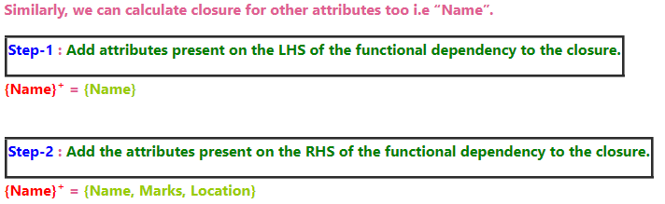

Slide 6
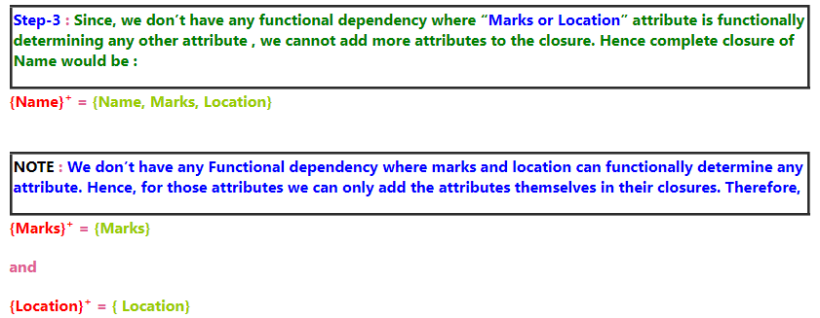

Slide 7
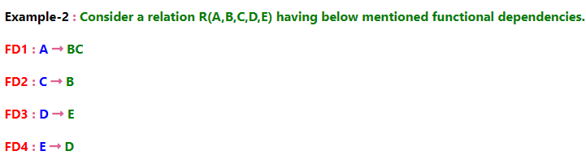
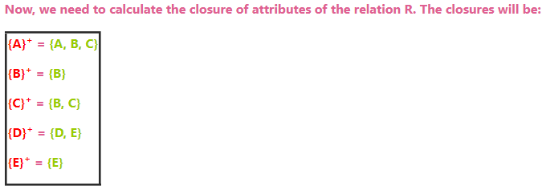

Slide 8
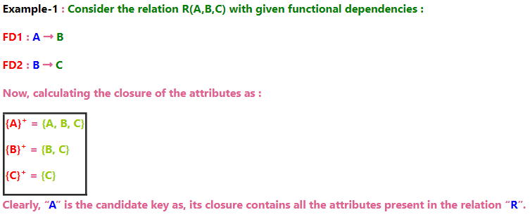
Closure Of Functional Dependency : Calculating Candidate Key
“A Candidate Key of a relation is an attribute or set of attributes that can determine the whole relation or contains all the attributes in its closure."

Slide 9
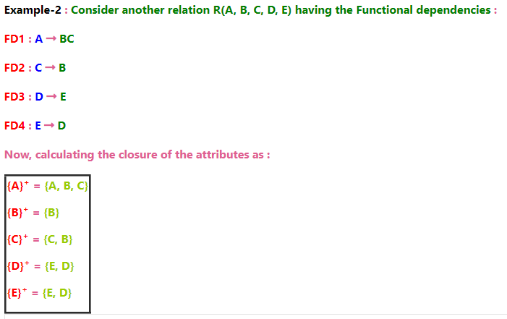

Slide 10
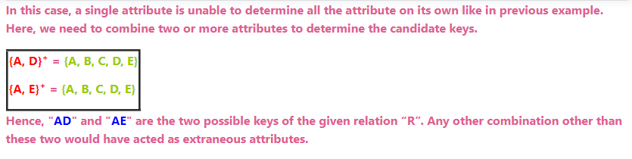

Slide 11
